Slide 1

Bitcoin Price Predictor
By:
Youssef ElNahas
Abubakar Waziri
Mohammed Sattar
Supervised by:
Dr Mohammed Temraz

Slide 2
Get to know the data
Timestamp | Open | High | Low | Close | Volume | Datetime
1360887300.0 | 26.63 | 26.63 | 26.63 | 26.63 | 17.98955015 | 2013-02-15 00:15:00+00:00
1360887360.0 | 26.63 | 26.63 | 26.63 | 26.63 | 0.0 | 2013-02-15 00:16:00+00:00
1360887420.0 | 26.60 | 26.60 | 26.60 | 26.60 | 20.0 | 2013-02-15 00:17:00+00:00

Slide 3
What we did to the data
Data Cleaning
Drop ‘datetime’ column
Interpolate missing values
Data Reduction
Drop ‘Volume’ column, irrelevant to task
Feature Engineering
SMA_200
ATR_168

Slide 4
Data after processing
datetime | Timestamp | Open | High | Low | Close | SMA_200 | ATR_168
2012-01-09 17:00:00 | 1326128400.0 | 6.9 | 6.9 | 6.5 | 6.5 | 5.83495 | 0.03255952380952383
2012-01-09 18:00:00 | 1326132000.0 | 6.5 | 6.6 | 6.5 | 6.5 | 5.844550000000001 | 0.03315476190476192
2012-01-09 19:00:00 | 1326135600.0 | 6.5 | 6.6 | 6.5 | 6.6 | 5.8546499999999995 | 0.033750000000000016

Slide 5
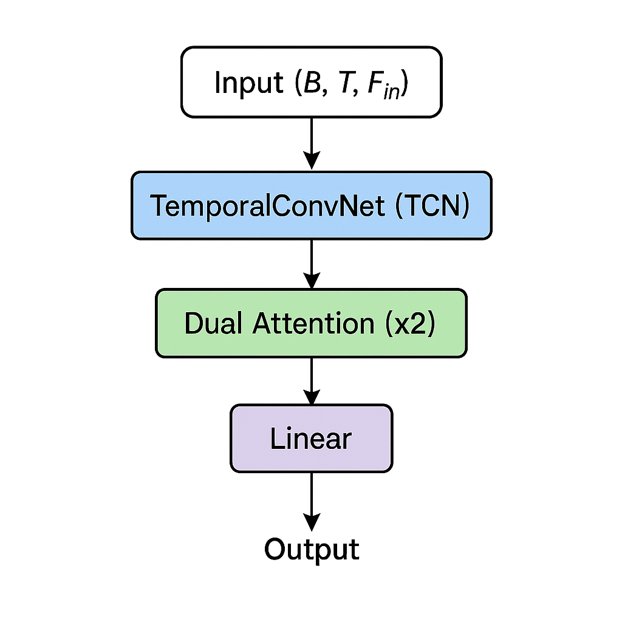
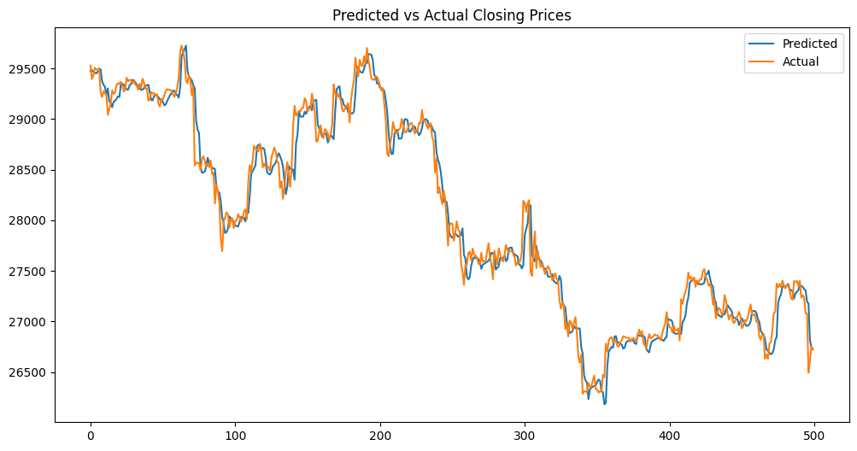
TCn with attention

Slide 6
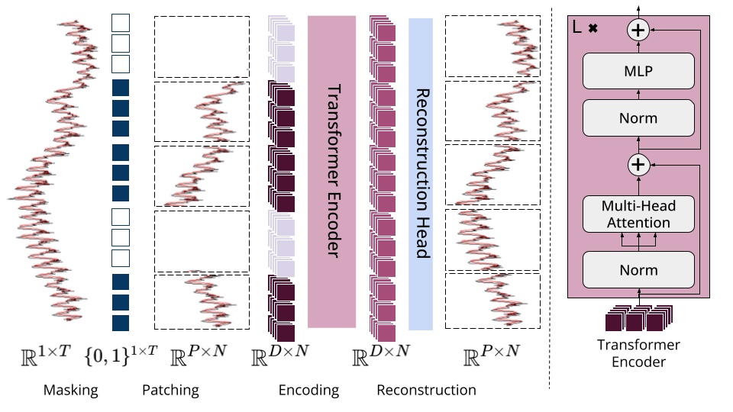
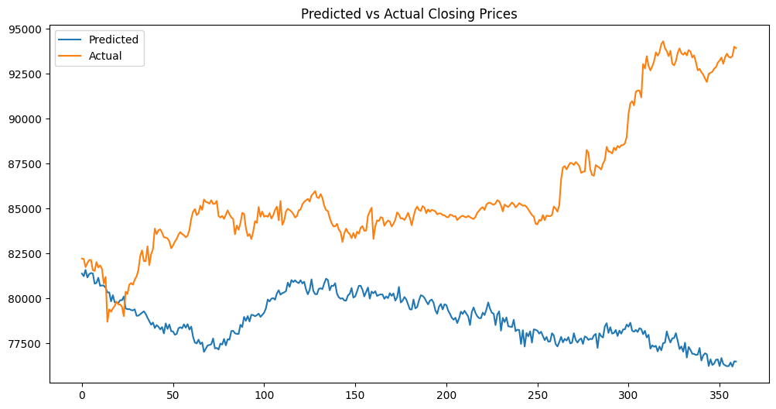
Moment transformer

Slide 7
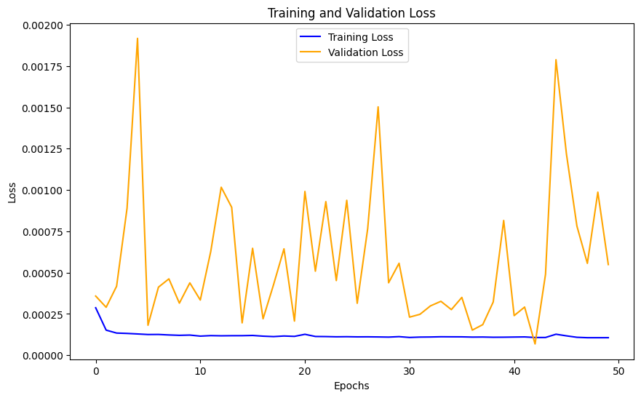
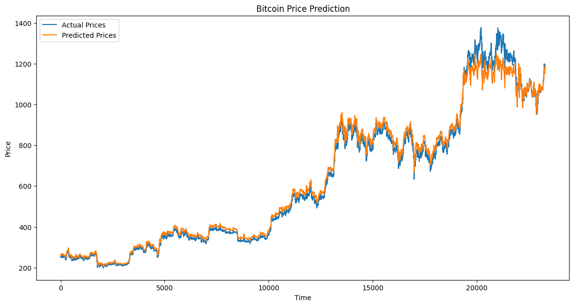
Gated Recurrent Unit (GRU)
Training Configuration:
Epochs: 50, Batch Size: 32, Loss Function: Mean Squared Error (MSE) Optimizer: Adam
Model Performance:
Final MSE on Test Set: 0.01737 Prediction Accuracy: The GRU model tracks the actual trend effectively, with smoother prediction curves and reasonable reaction to volatility.

Slide 8

QUESTIONS

